Slide 1
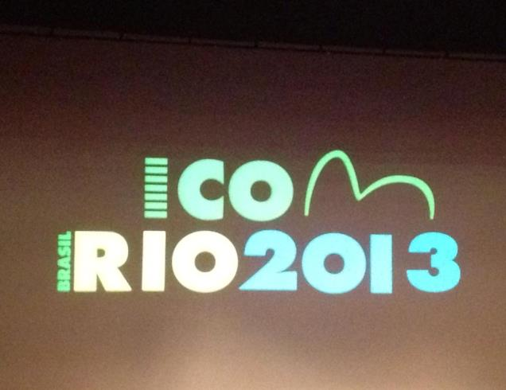
ICOM’s 23rd General Conference, Rio de Janeiro, 12-17 August 2013
The event:

Slide 2
The weather :
C’mon, Rio,
you can do
better than this:
-- oh,

Slide 3
The venue:
Cidade
das Artes,
Barra da Tijuca,
Rio de Janeiro

Slide 4
The delegates:
– some few of them –
– and all as
noisy as lions at
feeding
time –

Slide 5
– the flowers, the colors, the scents –

Slide 6
The ICR booth at the Museum Fair ---quite simply the best one there ---
Go, ICR!

Slide 7
Chair Rune in action, picking up a new member for ICR ---
Go, Rune!

Slide 8
ICR’s birthday party on 13 August
Happy
50th ,
ICR!

Slide 9
The Edison Carneiro Folklore Museum ---
--- site of ICR’s birthday celebration ---

Slide 10
The ICR Excursion on 15 August ---
--- starting with a windy wait for the bus --

Slide 11
The first stop: Sitio Roberto Burle Marx ---
--- a landscape park,
a botanical collection and a home museum, filled with a sense of timelessness and perfection ---

Slide 12
--- using native tropical plants as structural elements of design ---

Slide 13
--- in gardens which seem to have existed since the beginning of time ---

Slide 14
--- and where water features are used as free and natural forms.

Slide 15
A short pause before going on to the Home Museum ---

Slide 16
--- a museum filled with its founder’s “--- objectos poéticos e emocionais ---”
(his“--- emotionally poetic objects ---”)
--- all of them sublime examples of arts and crafts, made of every possible natural material and in every possible form:

Slide 17
--- textiles ---

Slide 18
--- ceramics ---

Slide 19
--- stone ---

Slide 20
--- wood, painted and natural ---

Slide 21
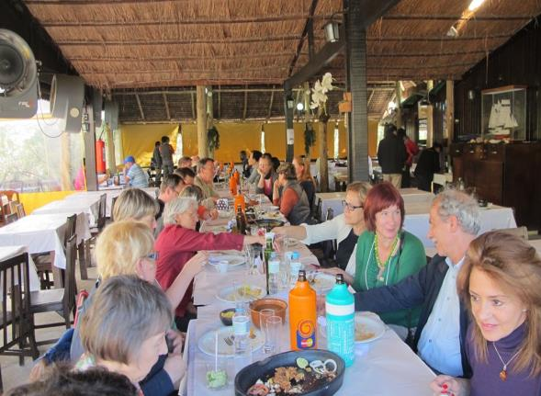
--
And to top off this fantastic visit – a great lunch ---
-but-

Slide 22
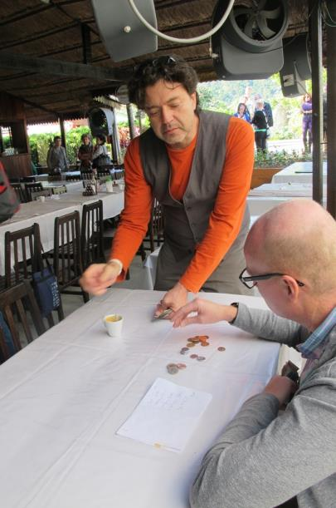
--- after which the ICR financial geniuses took over ---
(Hands on the table, guys, and what were you planning to do with those wads of bills?)

Slide 23
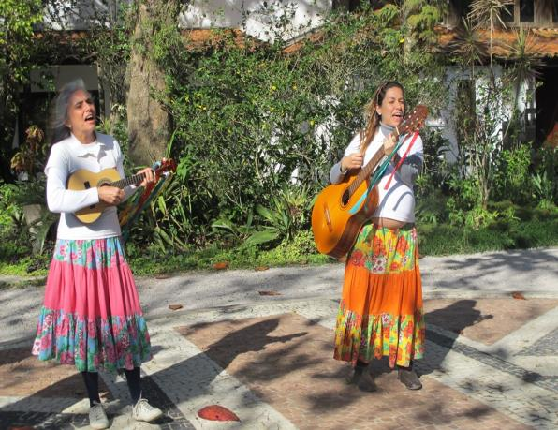
The second stop:
Museu Casa do Pontal --
--- with the most charming guides any museum could hope for ---

Slide 24
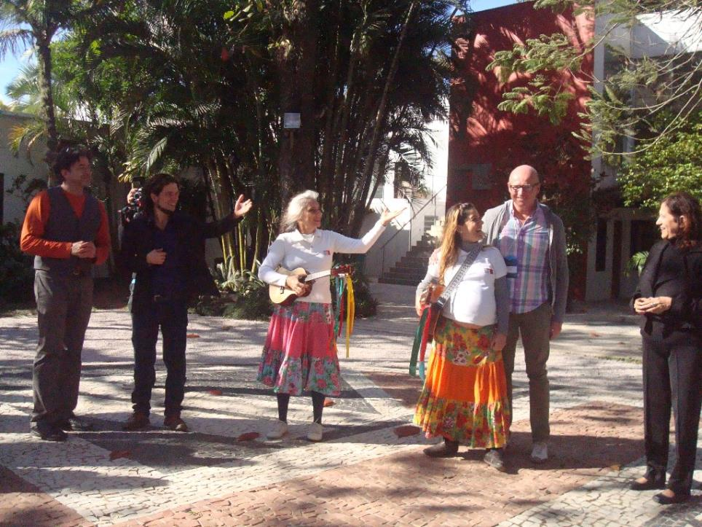
They and their colleagues pay homage to ICR’s new chair, Rune.

Slide 25
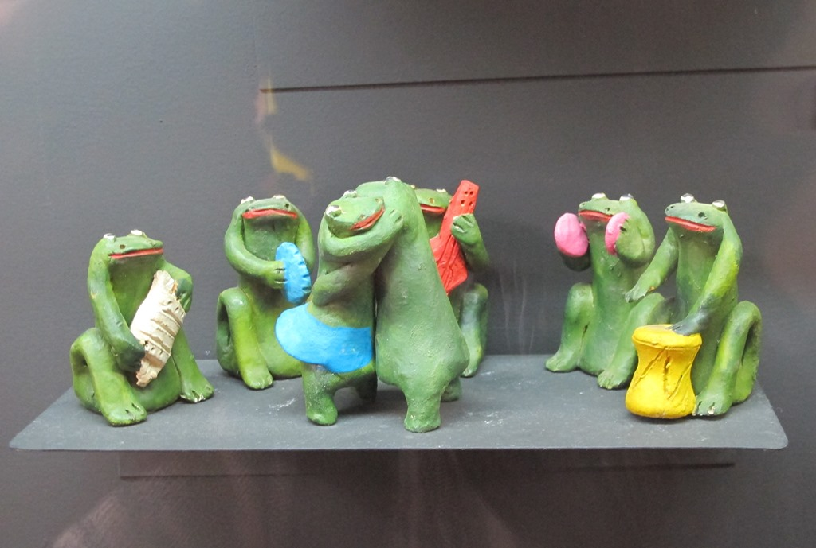
From the collections:
As artes do imaginário ---

Slide 26
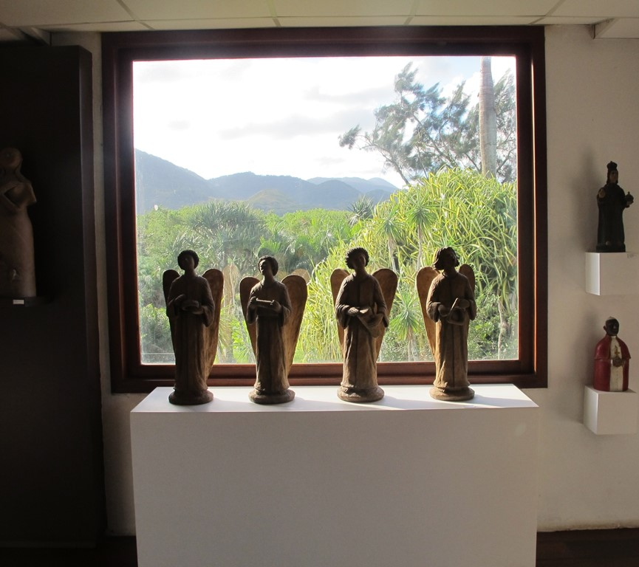
Religião ---

Slide 27
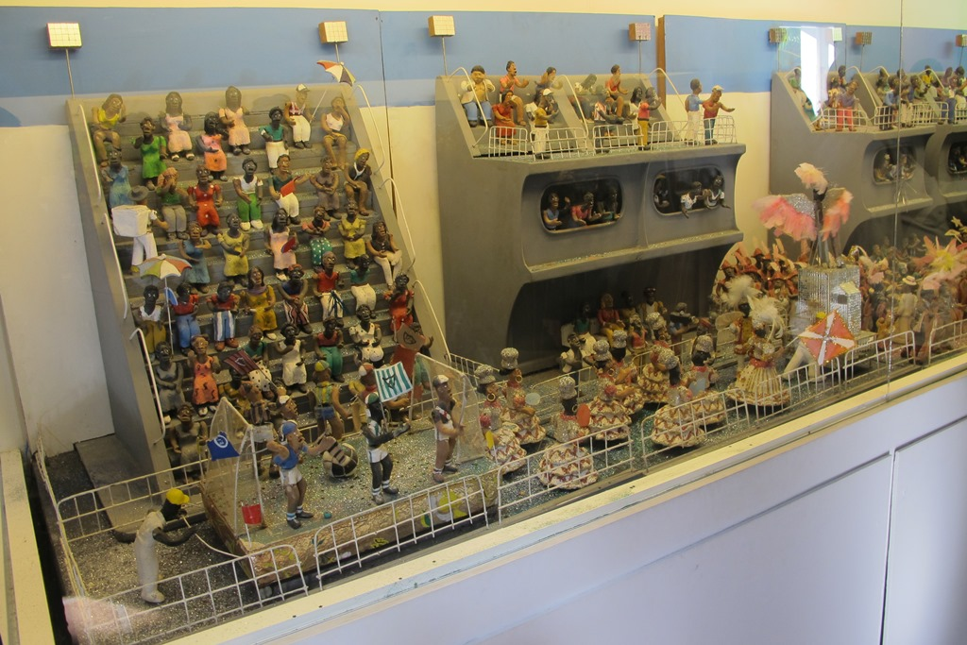
Carnaval ---

Slide 28
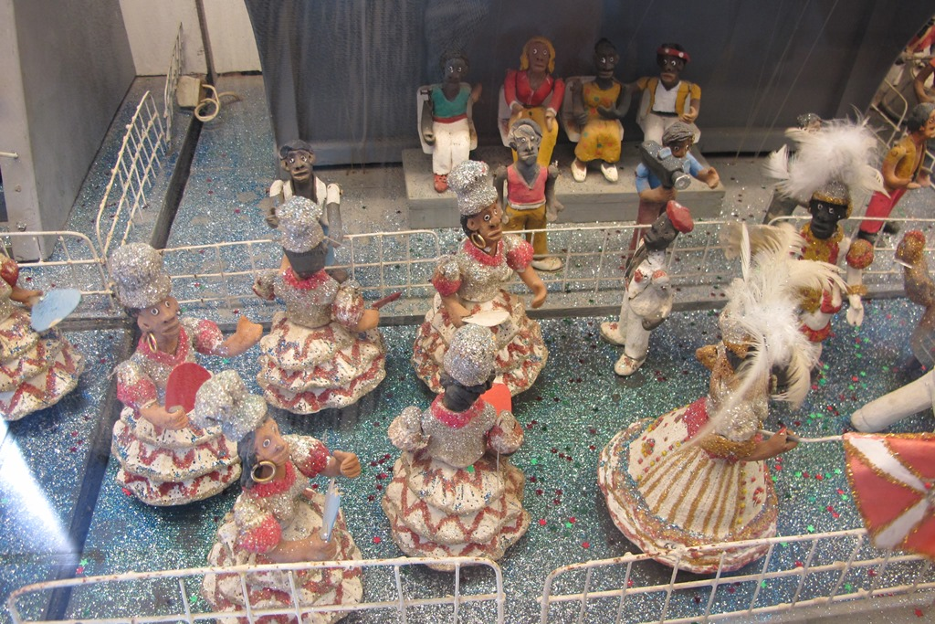
Carnaval ---

Slide 29
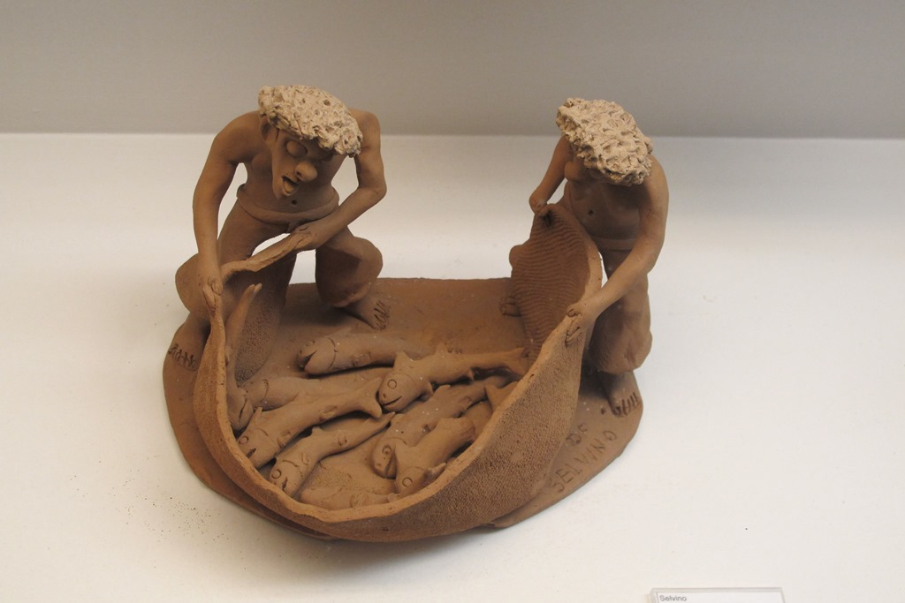
Profissões ---

Slide 30
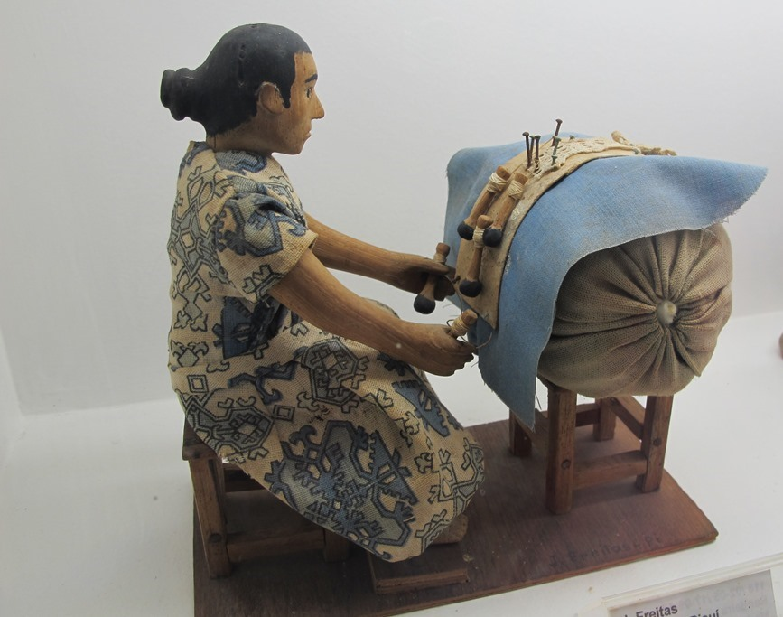
Profissões ---

Slide 31
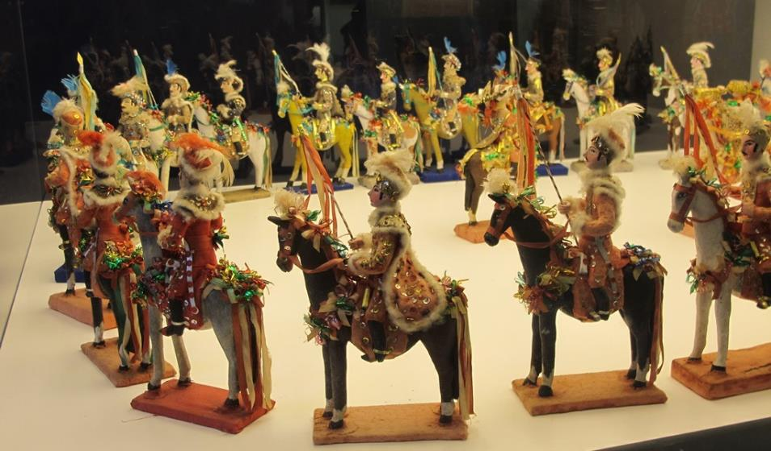
Festa popular? História do Brasil? Ou os dois?

Slide 32
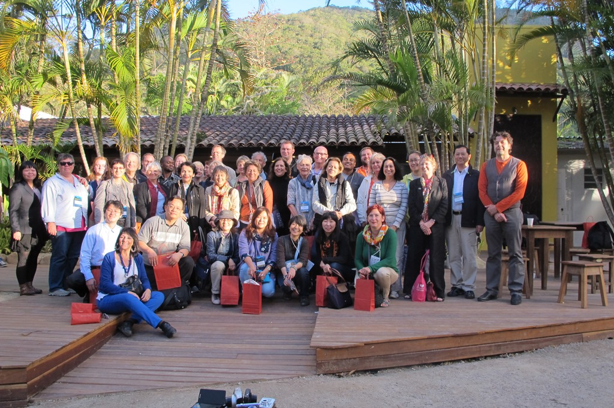
Time for the obligatory family picture – a great day, with smiles all around!

Slide 33
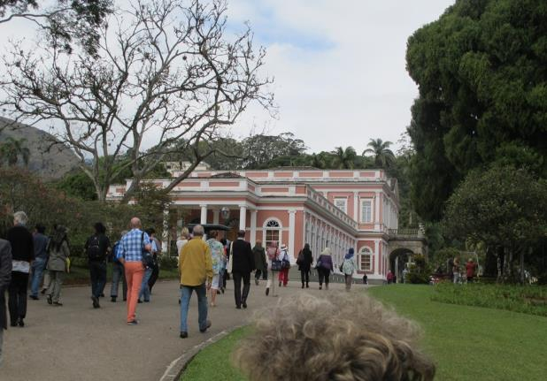
And on 16 August:
The ICOM Excursion to the Imperial Palace, Petrópolis ---
--- not at all up to ICR standards. Our excursion was far, far better.
–

Slide 34
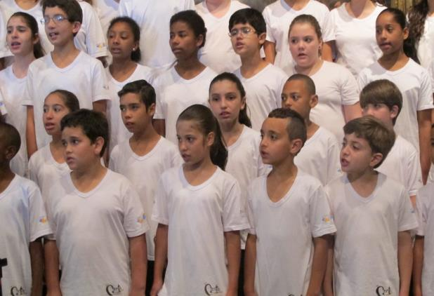
But they did give us the Children’s Choir of Petrópolis:
--- utterly charming, completely dedicated and immensely talented ---

Slide 35
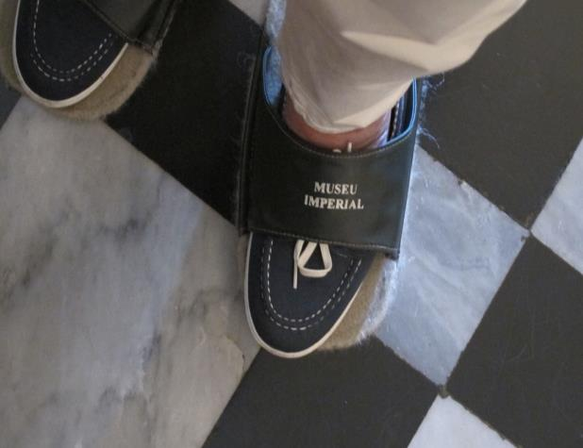
-- and the combination floor-polisher / floor protector ---

Slide 36
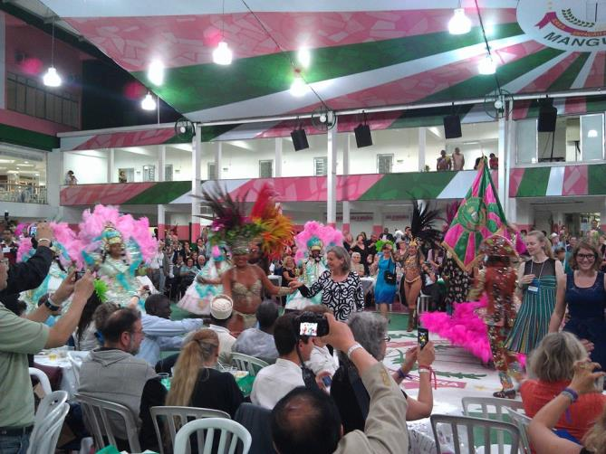
Then on 17 August a complete change of scene:
The Closing Party at Mangueira’s Palacio do Samba
The

Slide 37
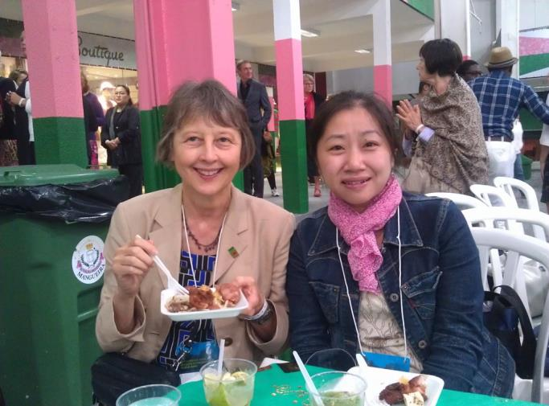
The Party-going Ladies

Slide 38
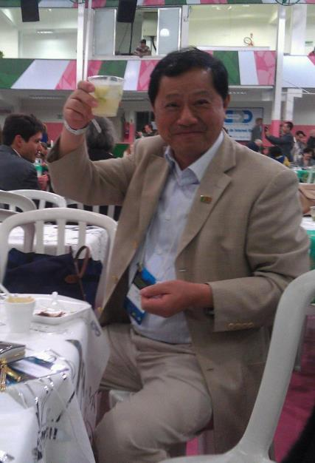
The Gentleman

Slide 39
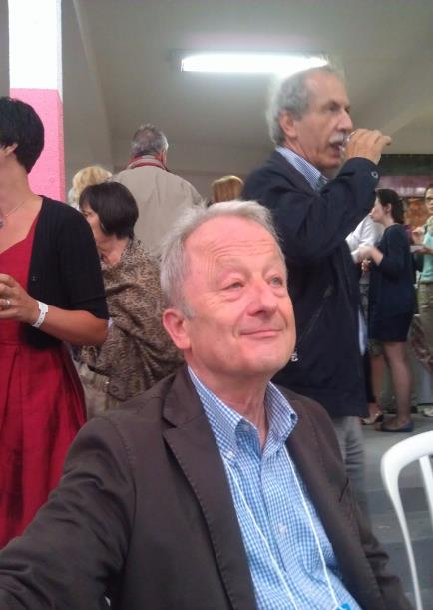
Two more Gentlemen

Slide 40
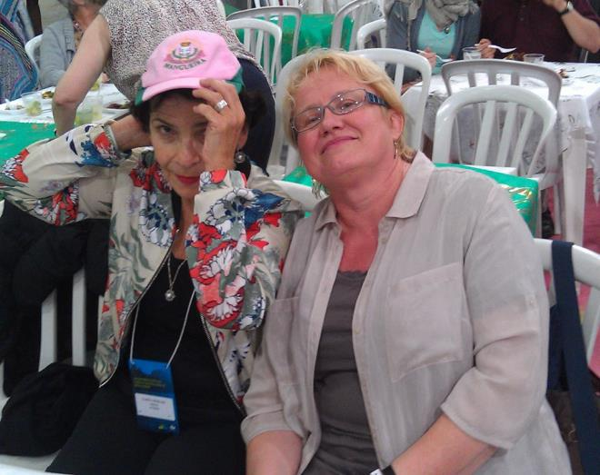
The Party Girls

Slide 41
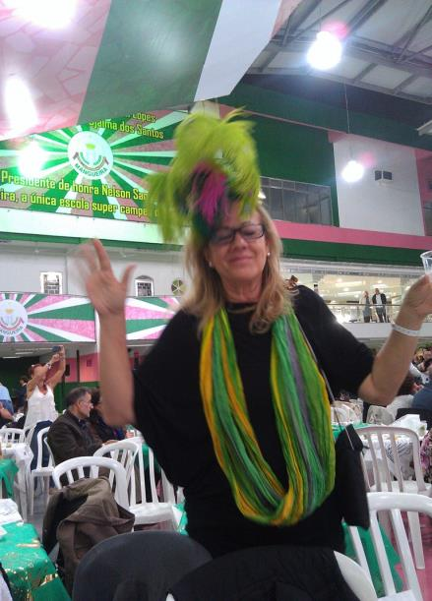
The Reveler ---
--- just love the hat!

Slide 42
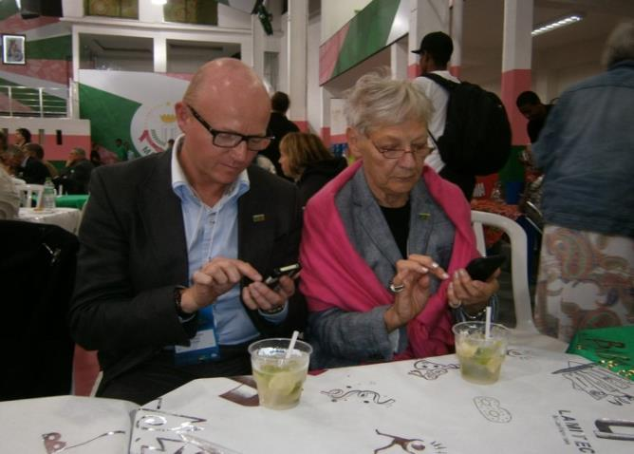
The Geeks --
ICR’s new chair and secretary
on the job, online,
27/7.
And then ---
SAMBA!

Slide 43
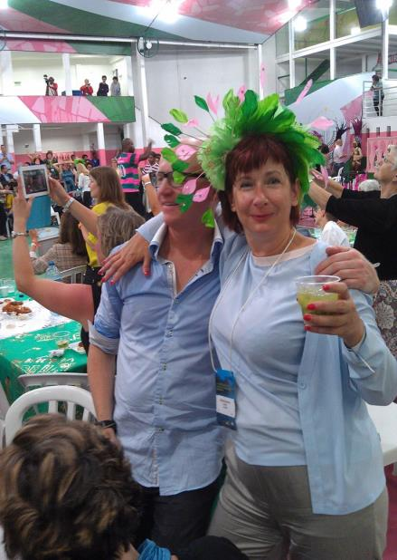
See:
The Merry-makers ---

Slide 44
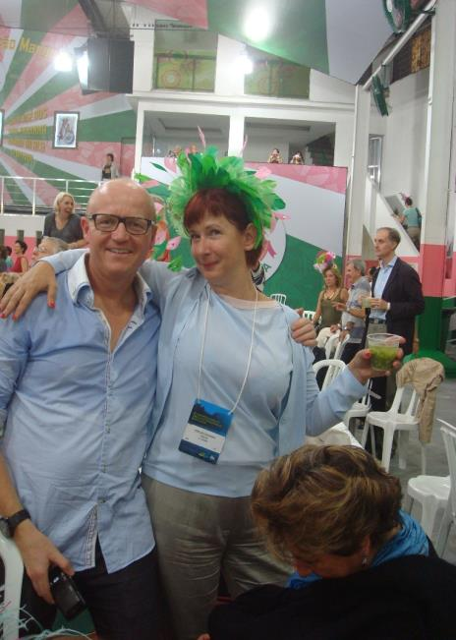
--- and the more the merrier Merry-makers ---

Slide 45
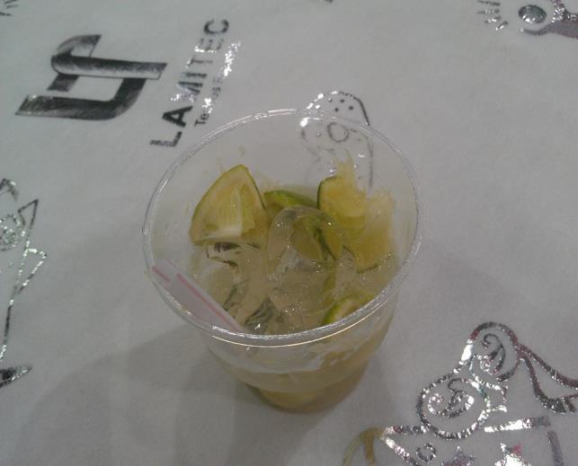
The Culprit ---
--- but how can anything so sweet be really wicked?

Slide 46
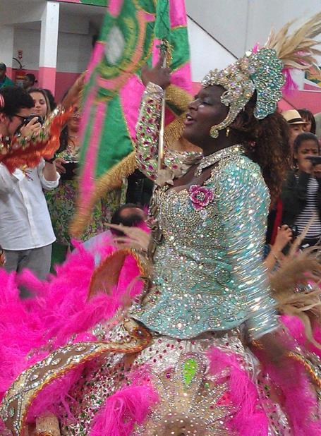
Over to our hosts, who included
the Professional ---

Slide 47
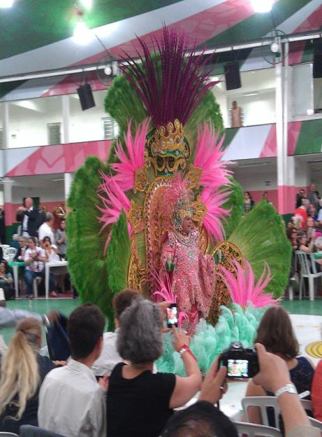
T
--- the Master of the Revels

Slide 48
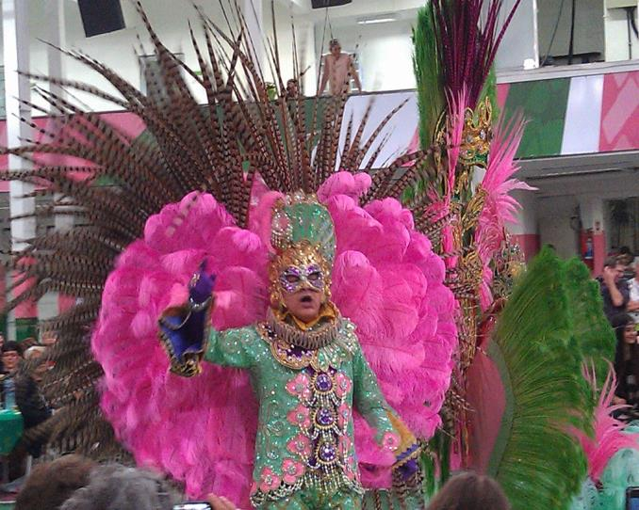
--- and the King of Misrule ---
--- until the coaches came for ICOM Cinderellas and Prince Charmings ---

Slide 49
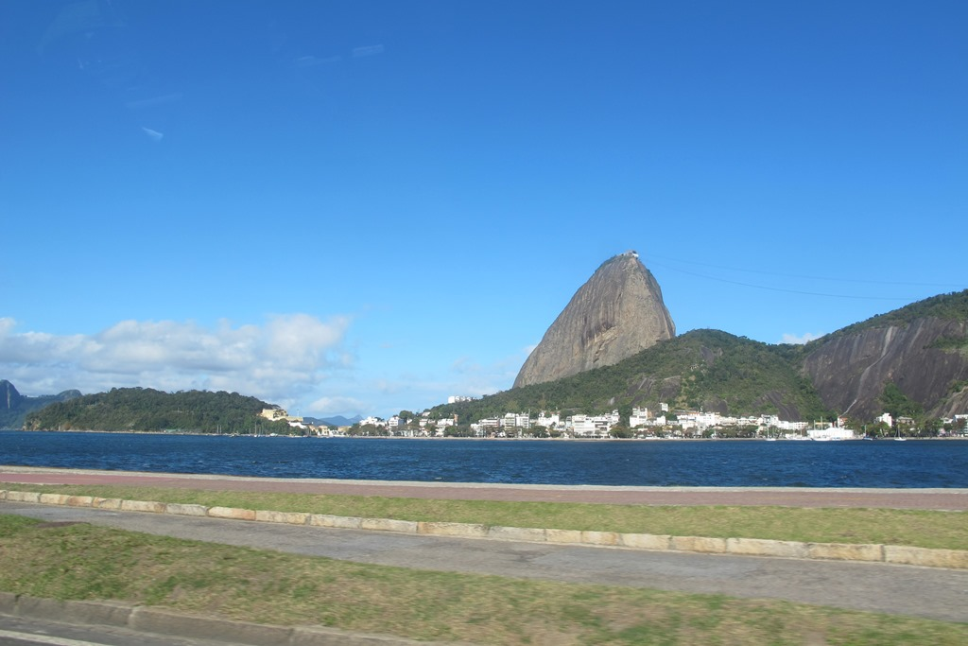
--- but for those of us on our way to Goiás and the
Post-conference Tour the next day, the best was yet to come !

